Slide 1
ADVENTURE WORKS DATA ANALYSIS
Group 2 presentation
Project Lead : Nike
Analyst : David
Designer : Micheal
Speaker : Abubakar

Slide 2
Key findings for Fact Analysis
Customer with Key 12132 ( kaitlyn ) has been purchasing with more amount than the others
Customer with key 11185 ( Ashley )has been purchasing more frequently than the others
The product for customer with key 12301 ( Nichole) has cost us more to manufacture than the other products we have manufactured

Slide 3
Key findings for product Analysis
Majority of our products are currently in development while only 33% are ready for sales
Most of our products have not been assigned a class yet and needs to be assigned
44% of our products in the table shows that it took few hours, not up to a day to manufacture but the rest took a day or few days

Slide 4
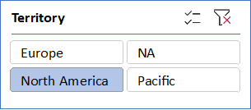
Key findings for Territory analysis
most of our destination in product delivery are in North america particularly in the united states according to the Data available

Slide 5
Key findings for Date Analysis
Between the interval of 5yrs, the year 2008 has yielded more sales for us than the rest , because of the holiday season.
The month of January, March, May , July, August, October and December of the year 2008 has been recorded to have the highest month of sales.
The third and fourth quarter of the year 2008 has yielded more sales than the rest

Slide 6
Key findings for Customer Analysis
28% of our customer have no child at all while the rest 72% have atleast 1 child.
51% of our customers are male while the rest are female showing gender preference of our products
Majority of our customers are earning $60k yearly

Slide 7
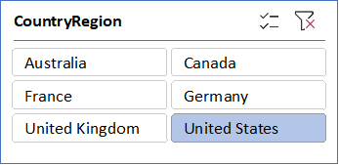
Key findings for Geography Analysis
The geography with the highest number of sales is the united states with over 58% of total sales is done there
19% of the total customers are with 4 sales territory key

Slide 8
Conclusion || Suggestion
Since sales skyrocketed during holiday, we should stock more preceeding the holiday season.
Since majority of our customers are Males, we should focus more on manufacturing male-centered products.
We should make our products fit in the yearly income of our customers for affordability.
We should manufacture products that support the western-culture since majority of our customer-base is from the West-Region.

